Slide 1
PDO Social Distancing Guide
Practice Social Distancing

Slide 2
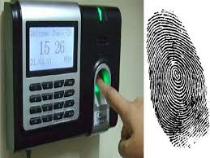
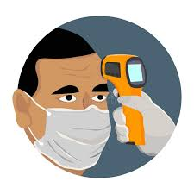
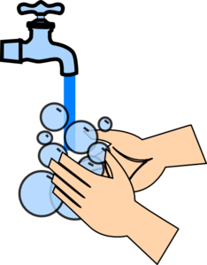
General Site Tips
All large site meetings stopped (e.g. HSE, Team meetings, etc.).
Avoid group Iftars and social gatherings.
Bio-metric systems deactivated to prevent employee gatherings and to reduce risk.
THIRD PARTIES ONSITE
Self Declaration Form
Temperature Checks
Seating Distances
Site recreation facilities and mosques closed.
Bus seating capacity reduced to 50%.
All site dining facilities closed, meals provided in disposable packs and eaten in cabins.
Always ensure Personal Hygiene

Slide 3
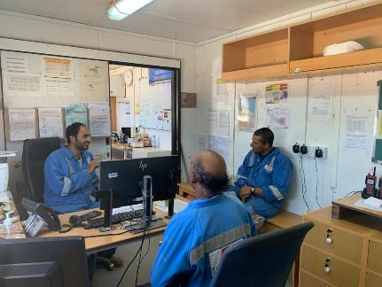
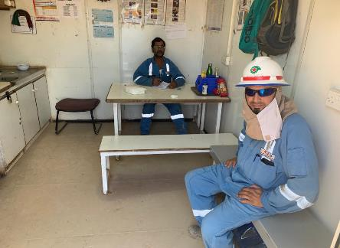
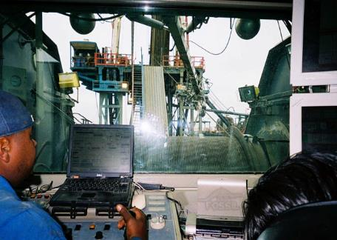
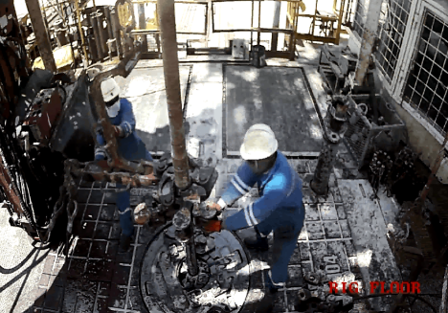
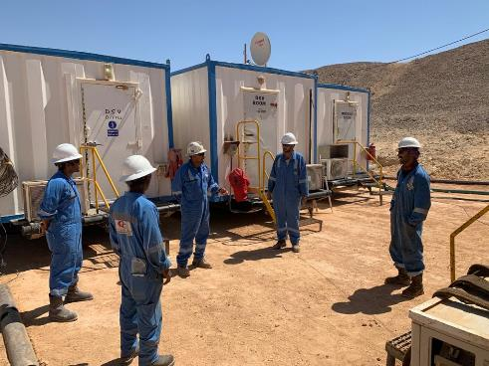
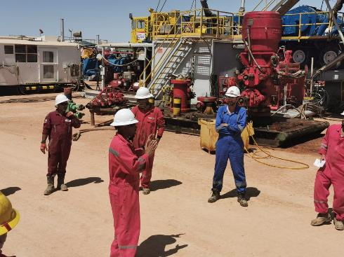
Tips When Working At Site
OFFICES - RIG SITE / SERVICE COMPANY
TEA ROOM / MEETING ROOM
Ensure
Avoid big gatherings
Minimum seating distance
Hygiene
Surface disinfection
WIRELINE UNIT / DOG HOUSE
RIG /HOIST FLOOR
NOTE: In cases where social distancing is practically impossible:
Ensure you have gloves, safety glasses and face mask/ balaclava to protect your mouth and nose.
Eliminate hand to mouth/nose contact without disinfecting your hands.
Ensure
Seating distance - Min 2 metres
Surface disinfection
Ensure
Seating distance
Hygiene
Surface disinfection
On Site Meetings
Ensure
Avoid large gatherings
Maintain safe distancing

